Slide 1
Fox to Namao Expansion
Contracts Administration

Slide 2
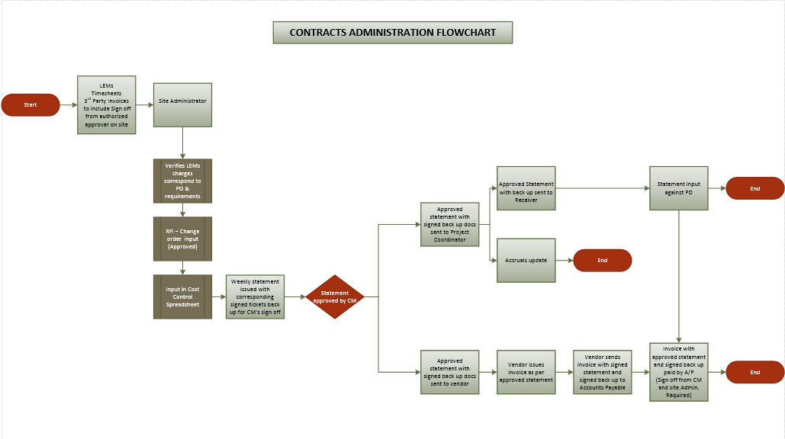

Slide 3
Accruals Reporting
Daily Tickets, Timesheets, LEMs input in Cost tracker
Approved by Inspector, Site Manager, CM, PM as applicable
Verified against PO / Contract
RFI, Change Orders Request input in Cost tracker
Approved by CM, PM
Weekly statement with signed tickets forwarded to Project Coordinator and Vendor (for inclusion with invoice)
Statement signed by Site Administrator and Construction Manager
Statement to include: PO#, Vendor’s name, AFE, Statement number (consecutive), locked by date i.e. July 15-21
Cost tracker emailed on weekly basis to Contracts Administrator and Project Coordinator

Slide 4
Weekly Accruals Reporting
Based on Cost tracker sheets as maintained by Field Office Administrator
Send once a week on an agreed day
(This information is independent from weekly/bi-weekly statements and or Progress Reports)
Information as built in Cost tracker is sufficient for this purpose

Slide 5
Weekly/Bi-Weekly Statements
Weekly/Bi-Weekly statements to include:
Tickets,
Timesheets,
3rd Party invoices,
Progress Reports,
Sign off on Tickets, Timesheets, 3rd Party invoices, Progress Reports as per authorized parties and as applicable to the PO:
Inspectors
Supervisor
Construction Manager
Statements, Progress Reports sign off:
Reviewed by Field Office Administrator
Sign off: Construction Manager/Office Administrator

Slide 6
Weekly/Bi-Weekly Statements
Vendor may provide his statement for approval
Statements must be accompanied by corresponding Tickets, Timesheets, 3rd Party Invoices where applicable
Statement with sign off by Construction Manager and Field Office Administrator is to be returned to vendor to be included with his invoice sent to Accounts Payable and to Project Coordinator to enable input against PO.
Where Vendor does not produce the weekly/bi-weekly statements, Field office to provide same with sign off as applicable to Project Coordinator

Slide 7
Inspectors - Timesheets
Timesheets are statements by itself
Field office to input timesheets in Cost Tracker (or daily tickets as needed by field to record daily, weekly, bi-weekly work)
This information will feed the weekly accruals reporting
Timesheet approved by Construction Manager/Office Administrator becomes a Statement (Additional sign off may be required, same are handled in Head Office)
Approved Timesheets in the field to be sent to Vendor and Project Coordinator
Vendor to include signed Timesheets with their invoice to A/P

Slide 8
Vendor’s Invoicing
Invoices (with tickets/timesheets/3rd party charges)
Vendor to email invoices to accountspayable@Pembina.com
Invoices must be accompanied by signed statements (Site Administrator and Construction Manager) with corresponding back up tickets/timesheets signed by authorized rep.
Invoices (Inspections Services)
Vendor to email invoices to accountspayable@Pembina.com
Invoices must be accompanied by signed statements and/or timesheets (Construction Manager)
Invoices (Progress payments)
Vendor to email invoices to accountspayable@Pembina.com
Invoices must be accompanied by signed Progress report (Site Administrator and Construction Manager) with corresponding back up as applicable according to PO.

Slide 9
